Slide 1
Human resources slide 1
KERJA
PRAKTEK

Slide 2
Human resources slide 6

Slide 3
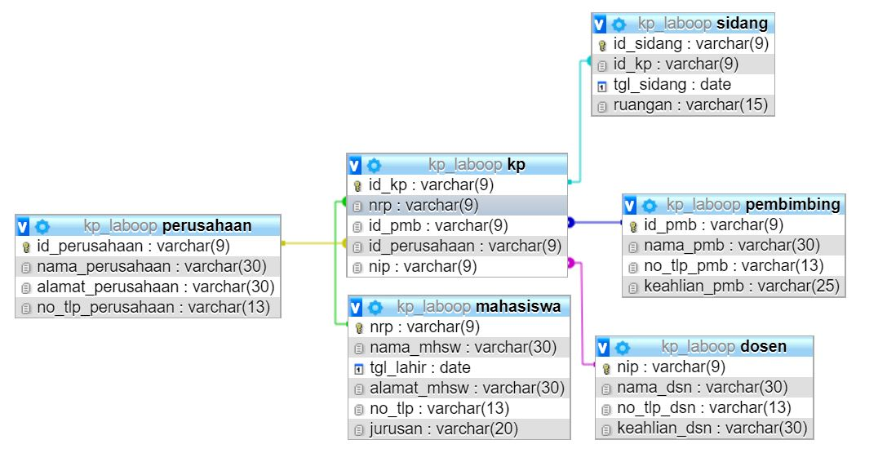
Human resources slide 2

Slide 5

Human resources slide 7

Slide 6
Human resources slide 7

Slide 7
Human resources slide 7

Slide 8
Human resources slide 7

Slide 9
Human resources slide 7

Slide 10
Human resources slide 7

Slide 11

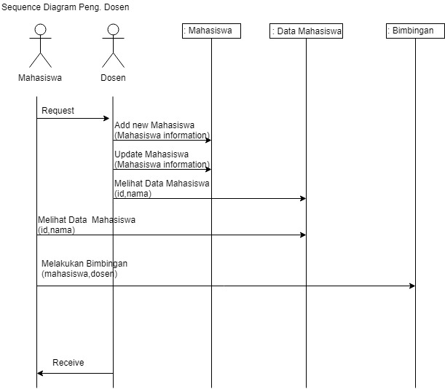
Human resources slide 8
Sequence Peng. Dosen

Slide 12
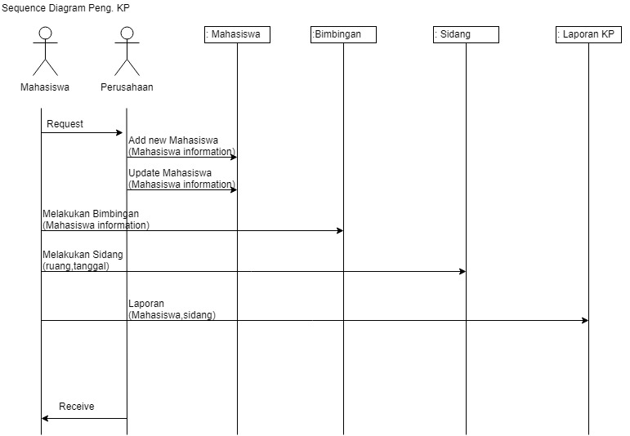
Human resources slide 8
Sequence Peng. KP

Slide 13
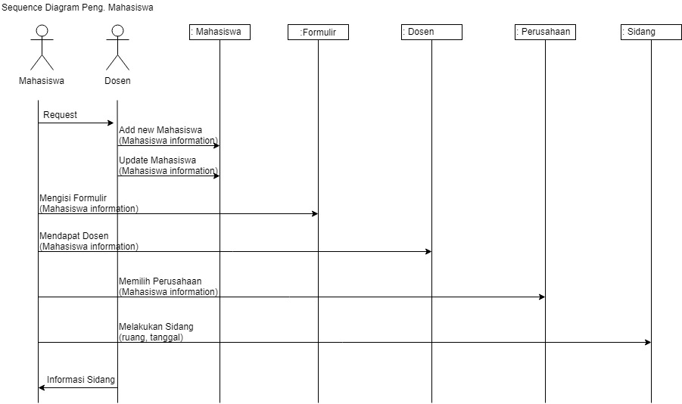
Human resources slide 8
Sequence Peng. Mahasiswa

Slide 14
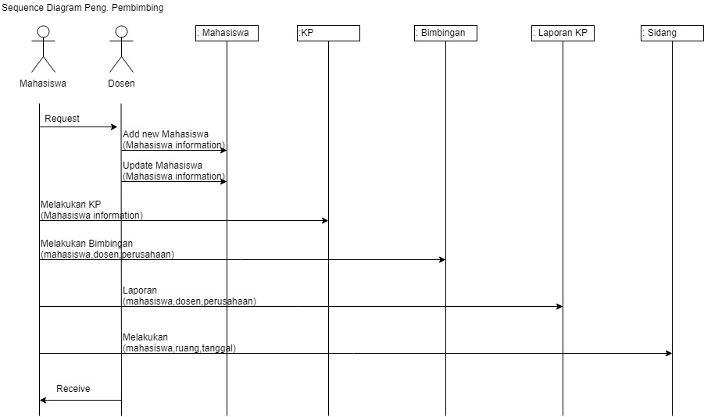
Human resources slide 8
Sequence Peng. Pembimbing

Slide 15
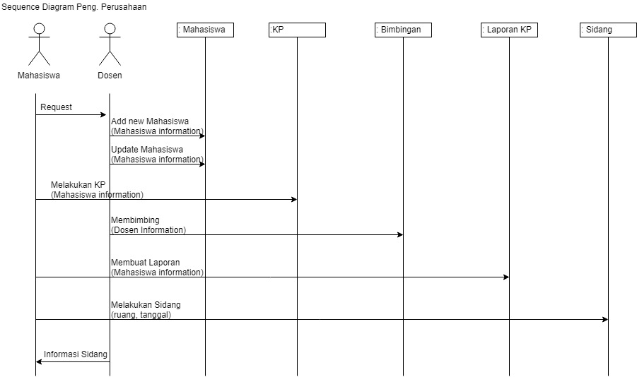
Human resources slide 8
Sequence Peng. Perusahaan

Slide 16
Human resources slide 10
Thank You

